Slide 1
Unit 33 Single-Phase Motors
Objectives:
List the different types of split-phase motors.
Discuss the operation of split-phase motors.
Discuss the start winding and the run winding.

Slide 2
Unit 33 Single-Phase Motors
Split-Phase Motors
Split-phase motor classifications:
  – the resistance-start induction-run motor
  – the capacitor-start induction-run motor
  – the capacitor-start capacitor-run motor
Split-phase motors use two separate windings to create the necessary rotating magnetic field. These windings are named the start winding and the run winding.

Slide 3
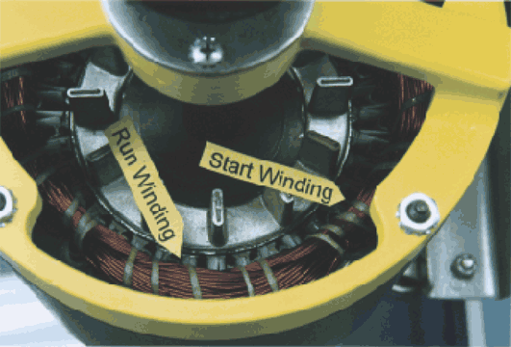
Unit 33 Single-Phase Motors
The start winding is made from small-gauge wire. The run winding is made from larger-gauge wire.

Slide 4
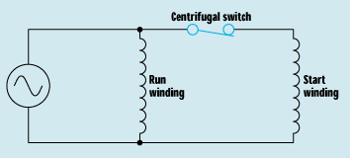
Unit 33 Single-Phase Motors
A centrifugal switch disconnects the start winding when the motor attains 75% of the rated speed.

Slide 5
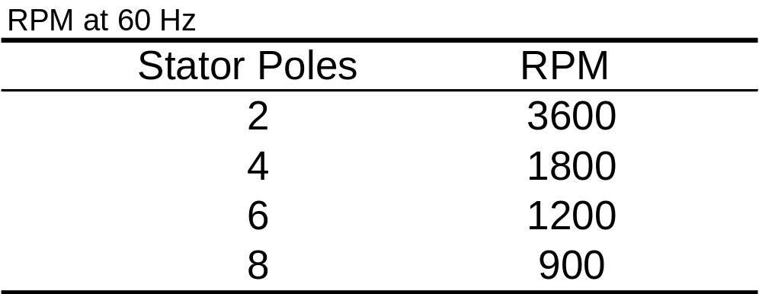
Unit 33 Single-Phase Motors
To calculate the speed of a rotating magnetic field: Speed = (120 x frequency) / poles.

Slide 6
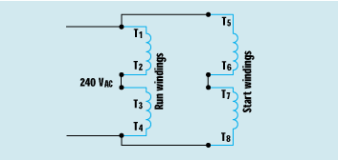
Unit 33 Single-Phase Motors
Split-phase motors use a squirrel-cage rotor. The stator windings induce a magnetic field in the rotor, which causes rotational torque.

Slide 7
Unit 33 Single-Phase Motors
Review:
Not all single-phase motors operate on the principle of a rotating magnetic field.
Split-phase motors start as two-phase motors by producing an out-of-phase condition for the current in the run winding and the current in the start winding.

Slide 8
Unit 33 Single-Phase Motors
Review:
The split-phase motor classifications are:
  – the resistance-start induction-run motor
  – the capacitor-start induction-run motor
  – the capacitor-start capacitor-run motor

Slide 9
Unit 33 Single-Phase Motors
Review:
Multispeed fan motors have high-impedance stator windings to prevent them from overheating when their speed is reduced.

Slide 10
Unit 33 Single-Phase Motors
Practical Application:
You are an electrical contractor, and you have been called to a home to install a well pump. The homeowner has purchased the pump, but doesn’t know how to connect it. You open the connection terminal cover and discover that the motor contains eight terminal leads marked T1 through T8.

Slide 11
Unit 33 Single-Phase Motors
Practical Application:
The motor is to be connected to 240 volts. At present, the T leads are connected as follows: T1, T3, T5, and T7 are connected together; and T2, T4, T6, and T8 are connected together. L1 is connected to the first group with T1, and L2 is connected to the second group with T2.
Is this the correct connection pattern?
Is it safe to energize? What might happen?
Should the connections be changed?
What is the correct connection pattern?

